Slide 1
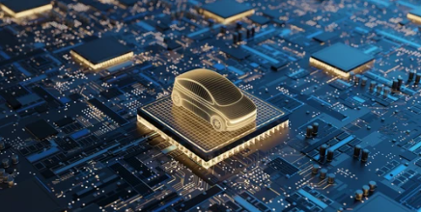

Automotive
Fabless
Company
Photodiode Overview
Dinh Hoang Luan 14-04-2025

Slide 2
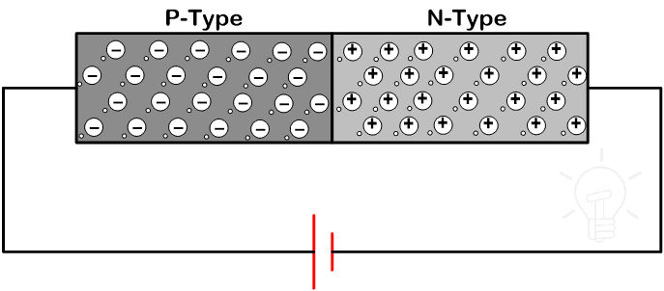
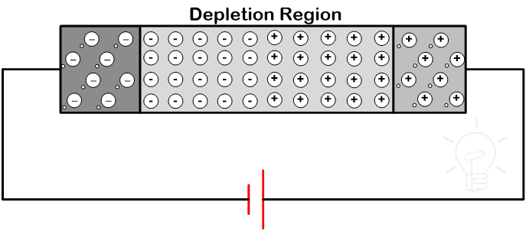
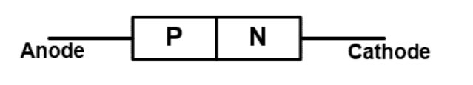
Diode Construction
“Di “= Two, and “Ode “= Electrodes
A diode is a two-terminal semiconductor device that allows current to flow in one direction only.
A diode has two terminals
One terminal is taken from the P-type layer and it is known as Anode (+).
The second terminal is taken from the N-type material and it is known as Cathode(-).
In the N-type region, electrons are the majority charge carriers and holes are minority charge carriers.
In the P-type region, the holes are majority charge carrier and the electrons are negative charge carriers.
Operation of Diode in Reverse Bias Condition
bos Semiconductors Confidential

Slide 3
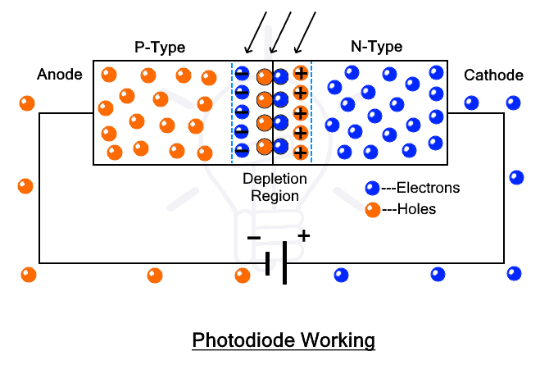
Photodiode Construction
A photodiode is a type of diode that converts light energy into electrical energy.
A PN photodiode is similar to a conventional PN junction diode. When a PN junction diode is reverse biased, the depletion region widens.
bos Semiconductors Confidential

Slide 4
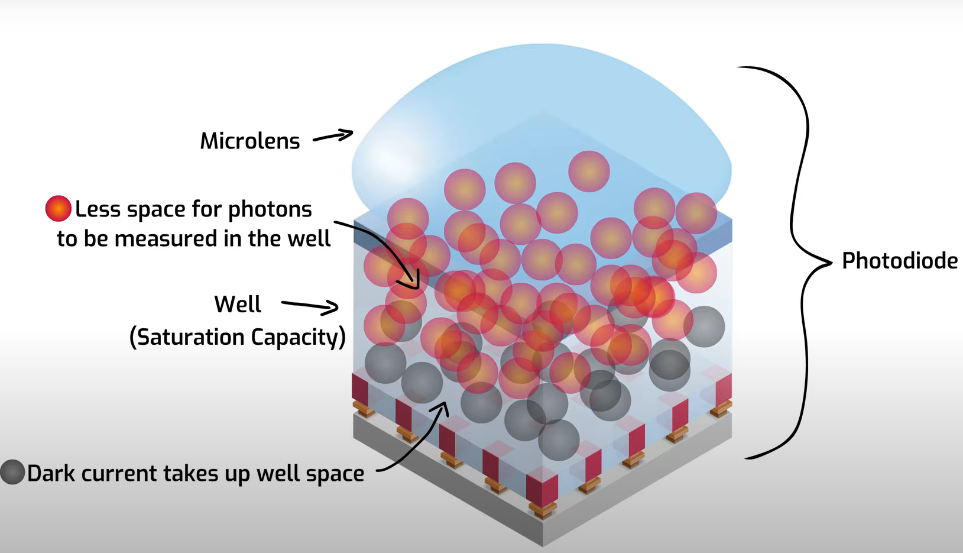
Definition of Dark Current
Dark current is the small amount of electrical current that flows through a photodiode or pixel in an image sensor even in complete darkness (when no light is present)
Thermal energy (heat-temperature) inside the sensor causes random electron generation. .
Dark current creates a fundamental noise signal, which builds or accumulates overtime within the pixel’s photodiode
bos Semiconductors Confidential

Slide 5
Automotive
Fabless
Company
Color Overview
Dinh Hoang Luan 14-04-2025

Slide 6
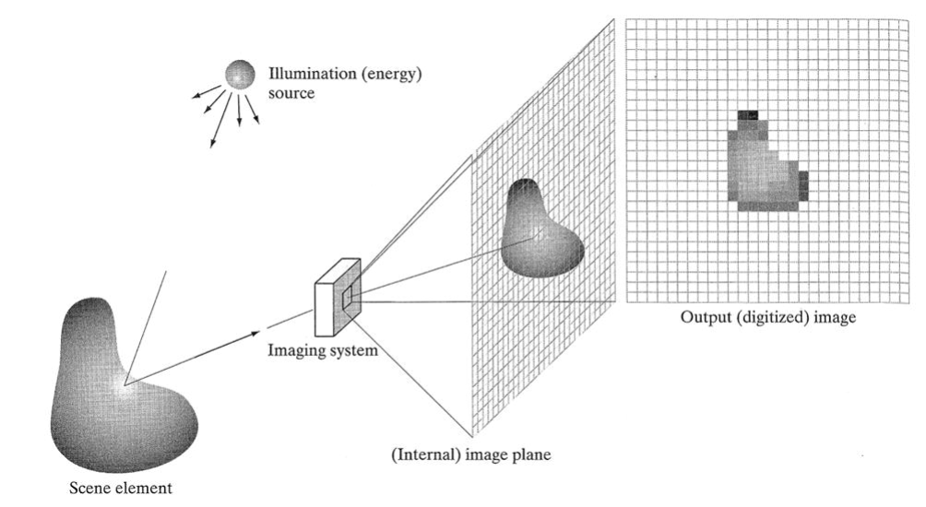
Definition of Image
An image is a spatial array of radiant energy measurements captured by a sensor.
bos Semiconductors Confidential

Slide 7

What is color? Color model? Color Channels?
Color is a human’s perception of an object’s reflected or emitted light. It depends on its wavelengths, brightness and its environment.
Color model is a mathematical way to represent colors using numbers (language for digital systems), instead of referring to complex physical properties like light wavelengths.
Example: Red is light with a wavelength of about 700 nanometers → RGB(255, 0, 0)
There are two main categories of color models: subtractive and additive.
An additive color model (like the RGB model) is based on transmitting light.
Subtractive color models (like CMYK) are based on reflected light.
Color channels are the individual components of color information when combined, form a complete color image. In digital systems. Example: An RGB model always has 3 color channels.
Red channel : represents the intensity of the red color in the image.
Green Channel: Represents the intensity of the green color in the image.
Blue Channel: Represents the intensity of the blue color in the image.
bos Semiconductors Confidential

Slide 8
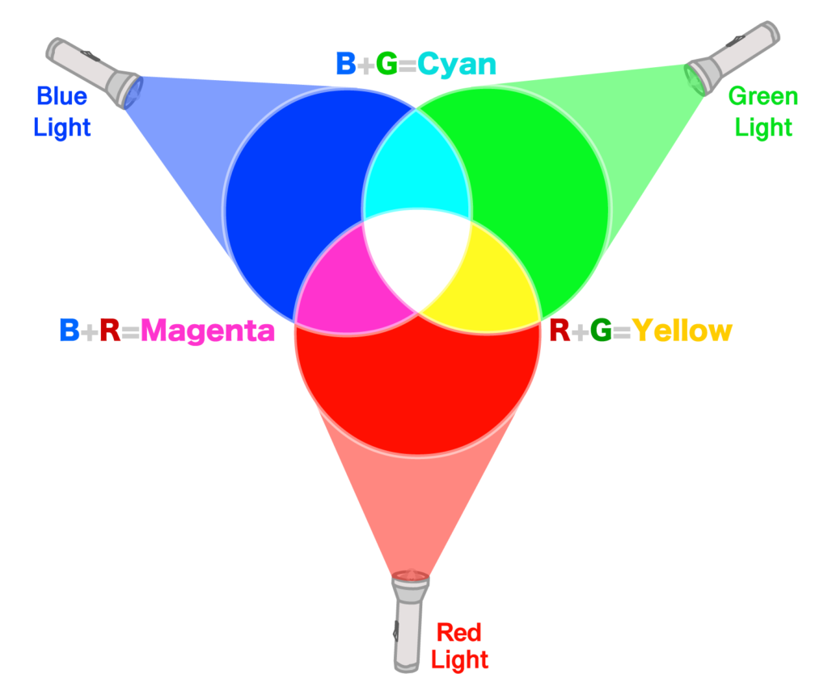
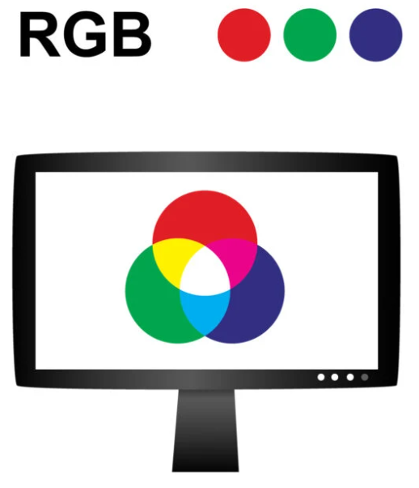
What is Additive color?
The additive color model explains how light interacts with the human eye to produce all colors in its spectrum. Our eyes and brain translate the light which bounces off objects into the perception of color.
Additive color works by mixing colors of light. The more colors of light add together, the closer get to white light
Additive primary colors are Red, Green and Blue (RGB).
Application: In Digital Displays RGB emissive displays like TVs and phones use additive color to create images. Subpixels emit different amounts of red, green and blue light to display color pictures.
Interactive Additive Color Mixer
bos Semiconductors Confidential

Slide 9
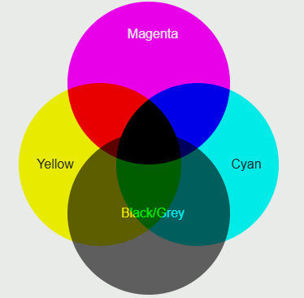
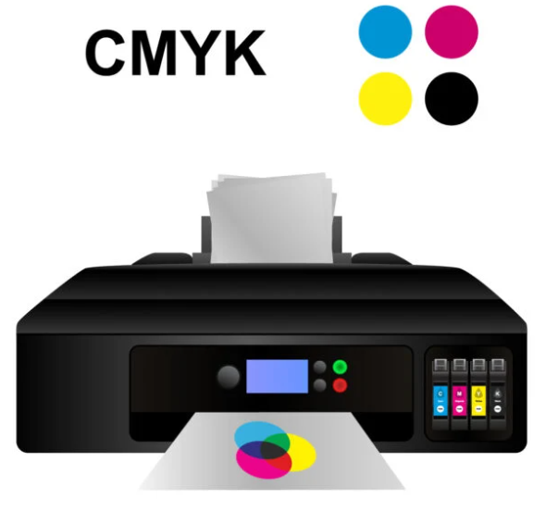
What is Subtractive color?
The subtractive color is the way our eyes naturally recognize and process color.
Subtractive color involves mixing physical materials like paint pigments, printing inks, and dyes. The more color materials you mix, the darker the color gets.
Application: In Printing CMYK inks are used in subtractive color mixing to print color images on paper. The colors and intensity of each ink layer are carefully calculated to absorb the right light wavelengths.
Interactive Subtractive Color Mixer
bos Semiconductors Confidential

Slide 10
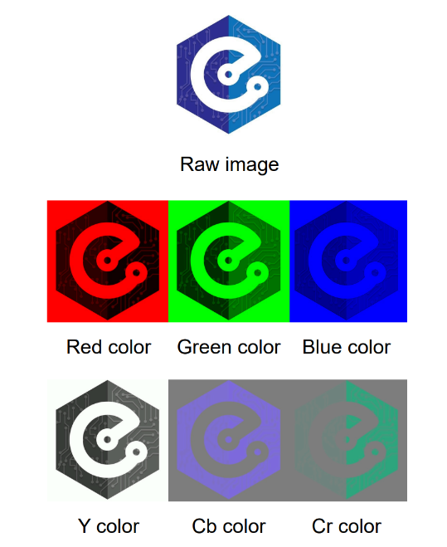
Why we need to convert RGB to YCbCr?
The RGB is not efficient for compression or transmission (All three channels carry both brightness and color information.) → Lead to redundancy.
YCbCr separates brightness from color.
Human eyes care more about brightness (Y) than color (CbCr), we detect sharp edges and fine detail mostly via luma (Y).
Video Standards use YCbCr.
bos Semiconductors Confidential
The Image with RGB and YCbCr color space

Slide 11
What is the difference between YCbCr and Y’CbCr?
Aspect | YCbCr (formal math‐space) | Y’CbCr (video signal actually see)
Symbol for Y component | Y → true luminance (linear, proportional to physical energy) | Y’ → luma (non-linear, after gamma-compression)
Gamma applied? | No – values are still in scene-linear light | Yes – values have been “gamma-shaped” for display / coding efficiency
Where it lives | Abstract color-science equations (e.g. matrix that converts linear RGB ➜ YCbCr) | SDI / HDMI cables, camera files, codecs, NLE timelines
Primary purpose | Mathematical separation of brightness vs. chroma before any signal processing | Band-limited video transmission & chroma-sub-sampling (4:2:2, 4:2:0…)
Applications | In Digital terms | In Digital terms
Think of it as | Color-space math | Practical video encoding
Is Y’CbCr a color space? Y’CbCr is not a color space, nor is it strictly a color model. It is only an encoding system.
bos Semiconductors Confidential

Slide 12
Automotive
Fabless
Company
Image Signal Processing (ISP)
Dinh Hoang Luan 14-04-2025

Slide 13
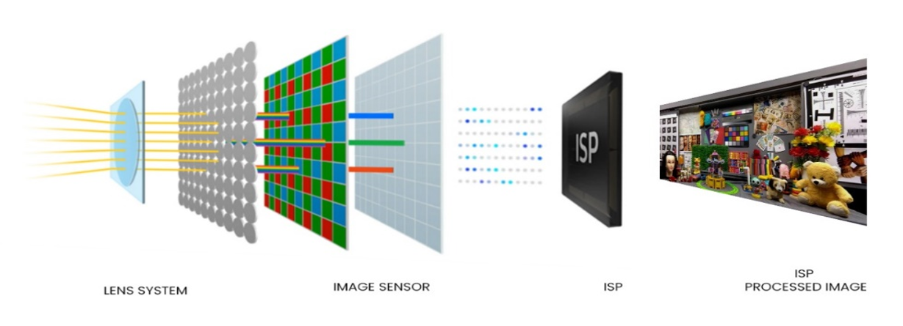
Definition of Image Signal Processing
ISP is used to process the output signal of the Image sensor (RAW image) to RGB/YUV image (to further processing or display)
The ISP module is a part of Camera.
Converting light information into an ISP processed image.
bos Semiconductors Confidential

Slide 14
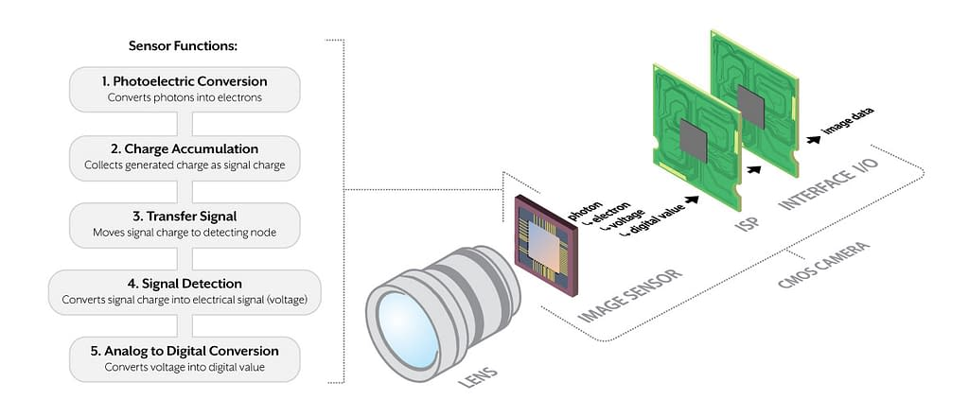
Types of Sensor Camera
There are two type of Sensor Camera: CCD or CMOS.
CMOS Camera offer numerous advantages over CCDs, including significantly lower power consumption, faster readout speeds, on-chip integration of additional circuitry, lower manufacturing cost, reduced blooming and smearing, support for global shutters, smaller and more scalable designs, and superior image quality due to advancements in noise reduction, sensitivity, and dynamic range.
Typical CMOS Camera Layout
bos Semiconductors Confidential

Slide 15
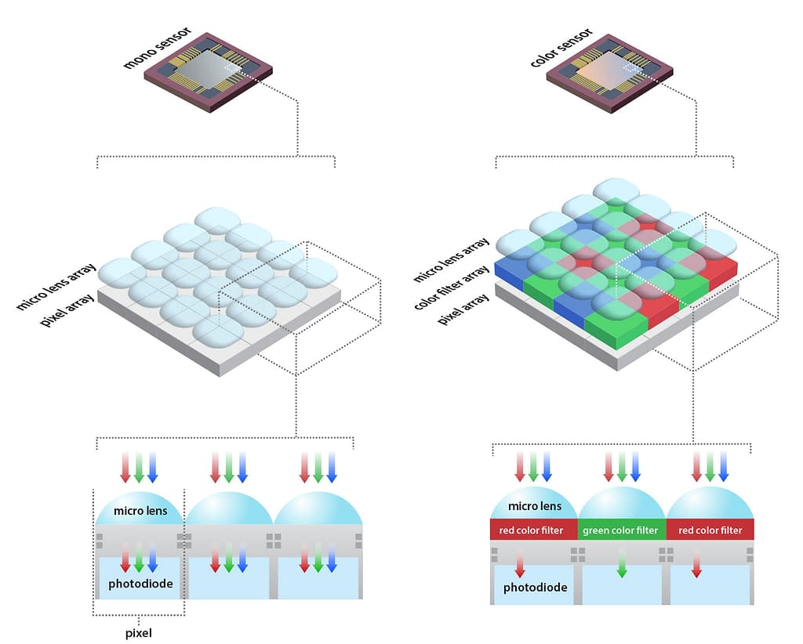
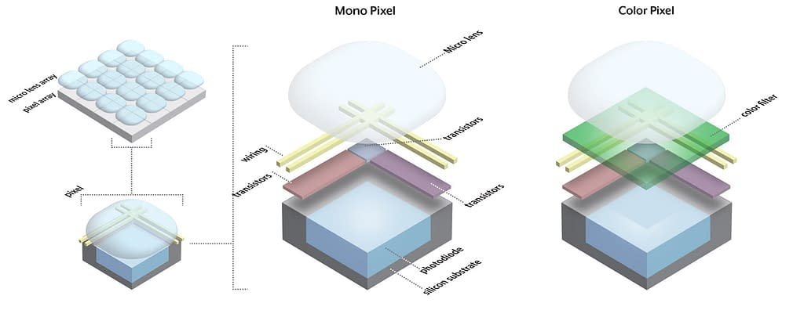
Types of Image Sensor
An image sensor is the electronic component in a camera that converts light (photons) into electrical signals (electrons).
Image sensors are colorblind by nature. They only detect brightness as a total of their spectral sensitivity and the spectrum of the incident light. But the Color Information gets lost.
A sensor with a Bayer pattern provides an image in Raw Bayer Pixel Format.
Mono Sensor and Color Sensor
Mono Sensor and Color Sensor Pixel

Slide 16
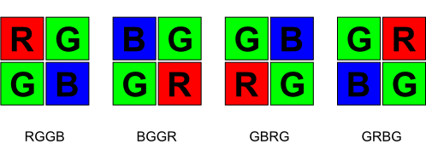
Bayer Pattern
Bayer format is a raw video format produced by image sensors that include a Bayer filter.
A Bayer filter is a color filter array in which RGB color filters are arranged on a grid of square photosensors.
A Bayer filter uses two green filter elements for each red and blue filter element.
The filter array can be arranged in 4 distinct patterns. Their names are derived from the order of the filters in a single 2x2 pixel square.
Bayer Format
bos Semiconductors Confidential

Slide 17
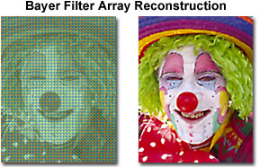
Raw Bayer Pixel Format
Raw Bayer Pattern Image
Raw Bayer after CFA
bos Semiconductors Confidential

Slide 18
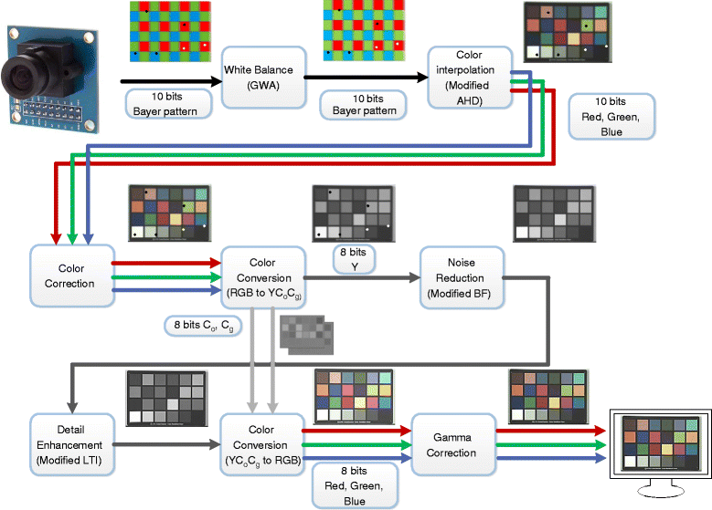
ISP Pipeline Process
Input of ISP: Raw Bayer domain image
Output of ISP: YCbCr/RGB domain image
bos Semiconductors Confidential

Slide 19
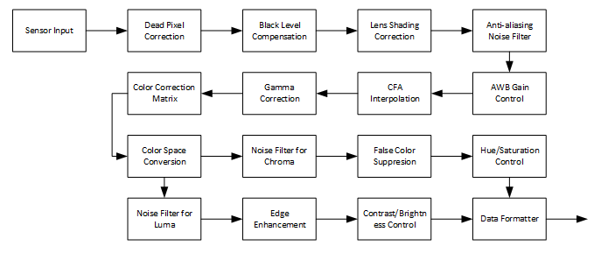
ISP Pipeline Process
Input of ISP: Raw Bayer domain image
Output of ISP: YCbCr/RGB domain image
bos Semiconductors Confidential

Slide 20
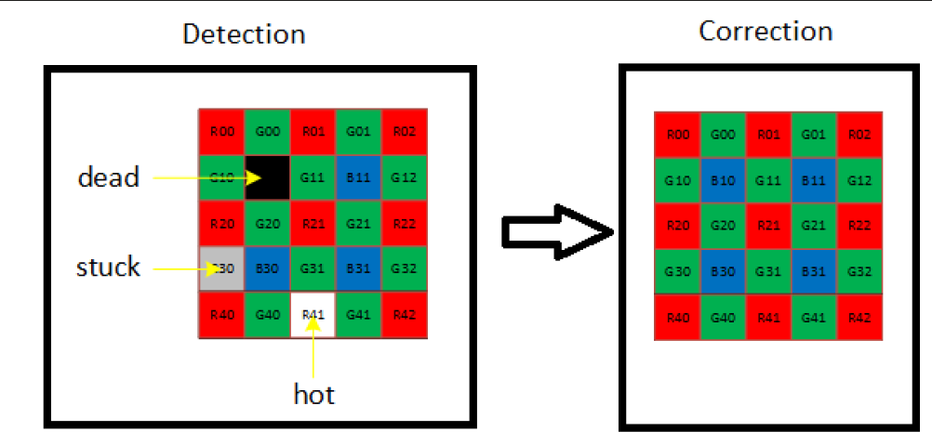
DPC (Dead Pixel Correction)
Dead or defective pixels typically stand out from their surroundings
An image sensor may have a certain number of defective pixels due to the uncertainty of manufacturing process, such as dusts, manufacturing faults, incompletion of exposure etc
bos Semiconductors Confidential

Slide 21
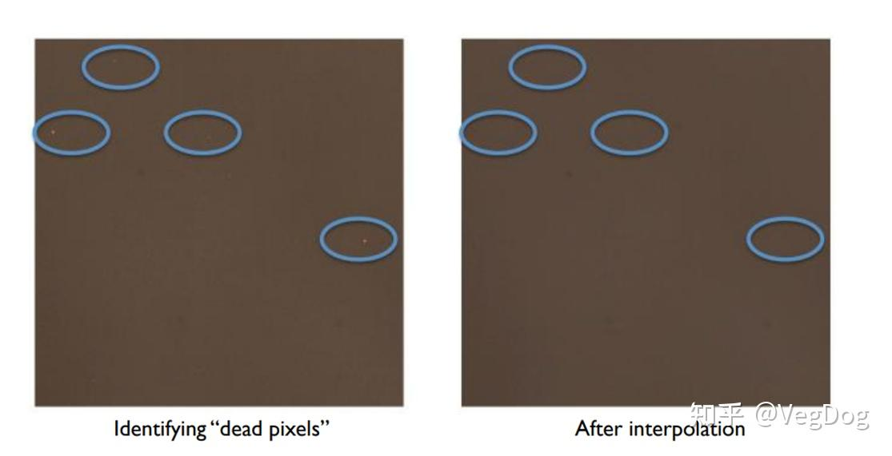
DPC (Dead Pixel Correction)
Inputs: Bayer = raw Bayer domain image
Outputs: Bayer domain image with dead pixels corrected for with gradient filter
bos Semiconductors Confidential

Slide 22
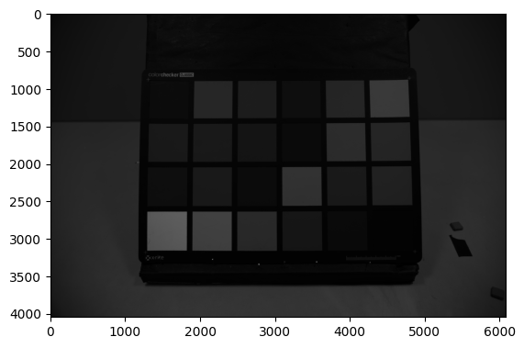
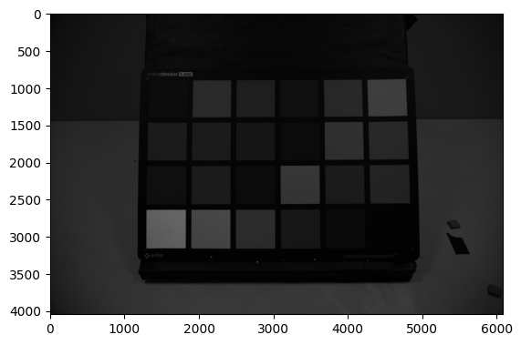
DPC (Dead Pixel Correction)
Inputs: Bayer = raw Bayer domain image
Outputs: Bayer domain image with dead pixels corrected for with gradient filter
Input Image
Output Image
bos Semiconductors Confidential

Slide 23
BLC (Black Level Compensation)
The black level, also known as the dark current, refers to the minimum signal output by an image sensor.
Sensor values for pixels with “no light” should be zero. However, this is not the case due to sensor noise.
The Black Level is used to define the signal level when the image data is 0. Due to the effect of dark current, the actual raw data coming out of the sensor is not the black balance we need (the data is not 0).
Input: Bayer image (2D numpy array)
Output: Bayer image after black level correction
Input Image
Output Image
bos Semiconductors Confidential

Slide 24

LSC (Lens Shading Correction)
For camera module, the sensor receives the image via lens. However, at the edge of lens, the light has a large angle with the optical axis of lens.
The intensity of light degrades with the increase of distance from optical axis. Meanwhile, the refractive index of diﬀerent colors are diﬀerent.
Len Shading Example
After Lens Shading Correction
bos Semiconductors Confidential

Slide 25
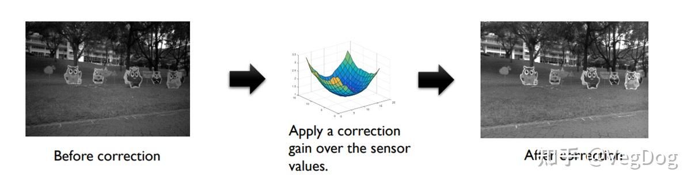
LSC (Lens Shading Correction)
Inputs: Bayer domain image after black level compensation
Outputs: Bayer domain image adjusted for lens shading
bos Semiconductors Confidential

Slide 26
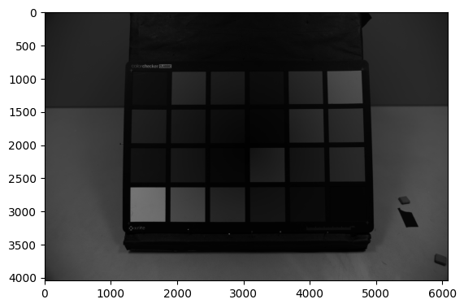
LSC (Lens Shading Correction)
Inputs: Bayer domain image after black level compensation
Outputs: Bayer domain image adjusted for lens shading
Input Image
Output Image
bos Semiconductors Confidential

Slide 27
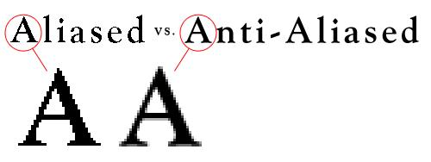
ANF (Anti-aliasing Noise Filter)
Anti-aliasing is the process of smoothing or filtering out these artifacts.
bos Semiconductors Confidential

Slide 28
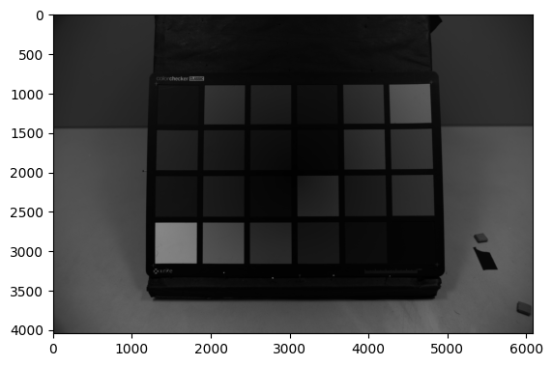
ANF (Anti-aliasing Noise Filter)
Inputs: Bayer domain image after lens shading correcting
Outputs: Bayer domain image after applying anti-aliasing
Input Image
Output Image
bos Semiconductors Confidential

Slide 29
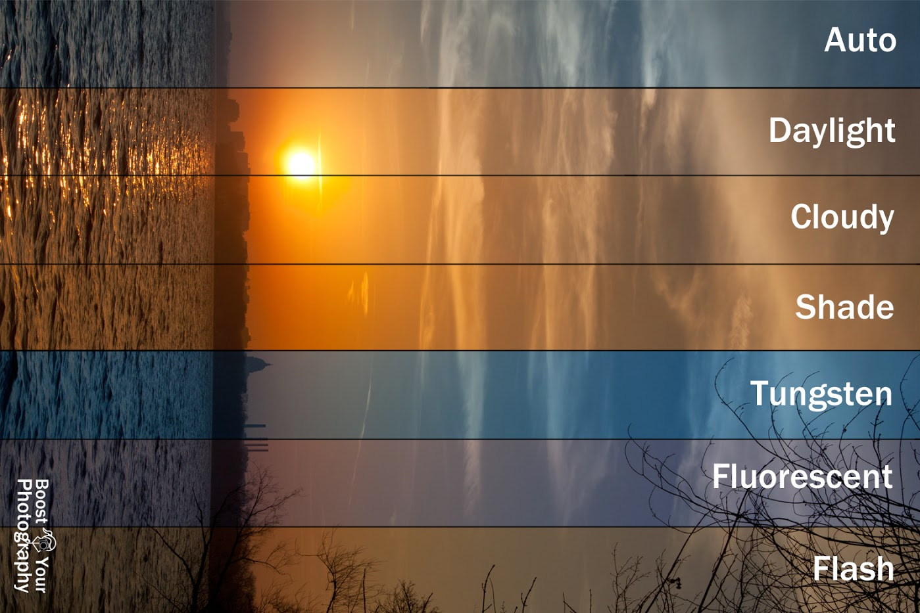
AWB (Auto White Balance Gain Control)
Image sensors do not perceive color like human eyes: Yellow under tungsten, Blue under LED, and Green under fluorescent.
White balance adjusts the red, green, and blue color channels so that white in the scene appears white in the image.
bos Semiconductors Confidential

Slide 30

AWB (Auto White Balance Gain Control)
Inputs: Bayer domain image after anti-aliasing noise filter
Outputs: Bayer domain image after auto white balance
Input Image
Output Image
bos Semiconductors Confidential

Slide 31
AWB (Auto White Balance Gain Control)
Inputs: Bayer domain image after anti-aliasing noise filter
Outputs: Bayer domain image after auto white balance
Input Image
Output Image
bos Semiconductors Confidential

Slide 32
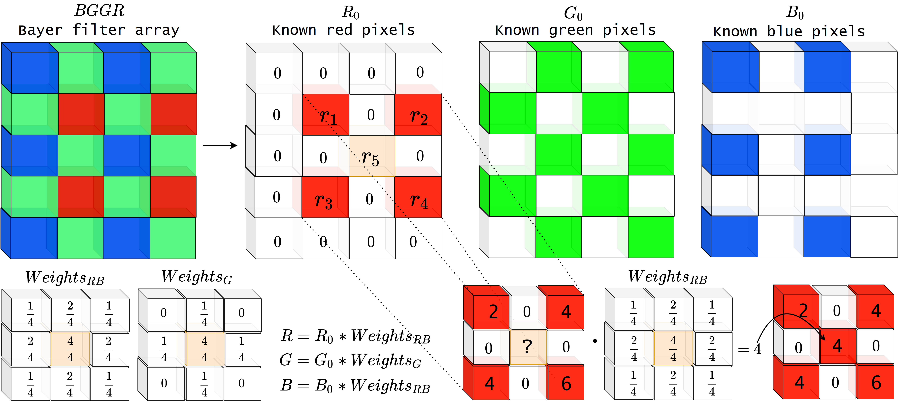
CFA (Color Filter Array Interpolation)
CFA Interpolation, also known as demosaicing, is the process of converting a Bayer pattern image (where each pixel only holds one color: R, G, or B) into a full RGB color image, where each pixel contains all three color components.
bos Semiconductors Confidential

Slide 33
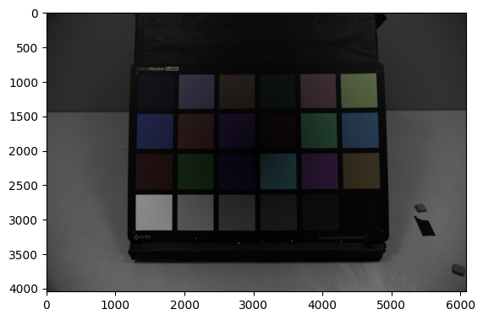
CFA (Color Filter Array Interpolation)
Inputs: Bayer domain image after auto white balance
Outputs: 8-bit RGB image
Input Image
Output Image
bos Semiconductors Confidential

Slide 34
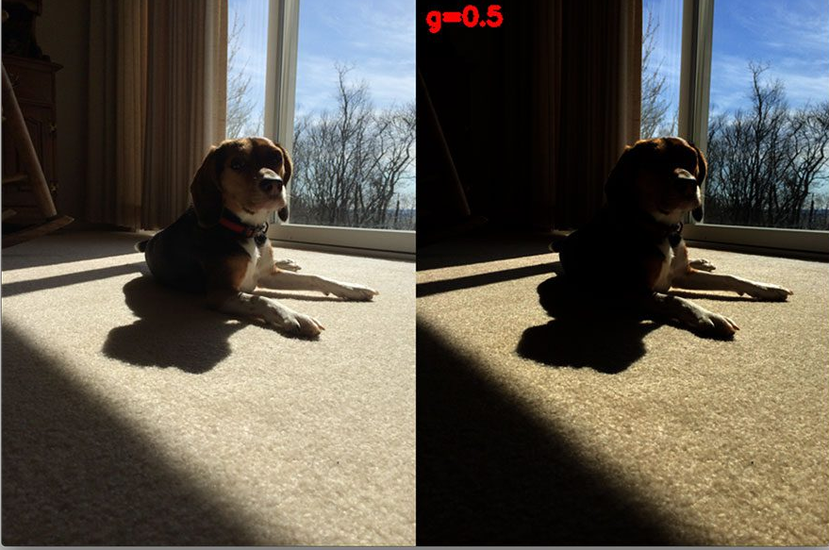
Gama Correction
Gamma correction is the process of adjusting the brightness and contrast of an image using a nonlinear curve.
bos Semiconductors Confidential

Slide 35
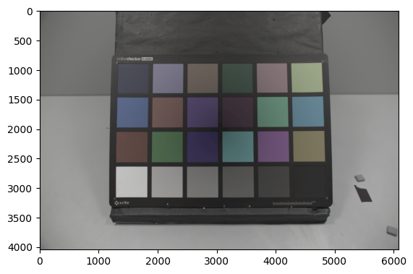
Gama Correction
Inputs: 8-bit RGB image (RGB image right after demosaicing)
Outputs: RGB image after gamma correction
Input Image
Output Image
bos Semiconductors Confidential

Slide 36
Color Space Conversion
Color space conversion transforms image data from one color representation (color space) to another.
Why we need to convert RGB to YUV?
Feature | RGB | YUV / YCbCr
Definition | Red, Green, Blue — primary colors | Y = Luma (brightness), U & V = chroma (color)
Storage | Full color at each pixel (3 channels) | Luma at each pixel, chroma often subsampled
Data Width | 24 bits per pixel (8 bits x 3) | 16 bits (YUV 4:2:2) or 12 bits (YUV 4:2:0)
Color Fidelity | High — full color info per pixel | Lower chroma fidelity (depends on subsampling)
Bandwidth | High | Lower (optimized for compression and transmission)
Perceptual Efficiency | Poor — treats R, G, B equally | Better — uses how humans perceive color
Subsampling? | ❌ No | ✅ Yes (e.g., 4:2:2, 4:2:0)
Editable Channels | R, G, B independently | Y for brightness, UV for color
Common in | Displays, graphics, sensors | Video codecs, compression, broadcast
Supported by ISPs | Yes (for input and output) | ✅ Often output format (especially in video)
Color Space | Additive color space | Luminance + chrominance model

Slide 37
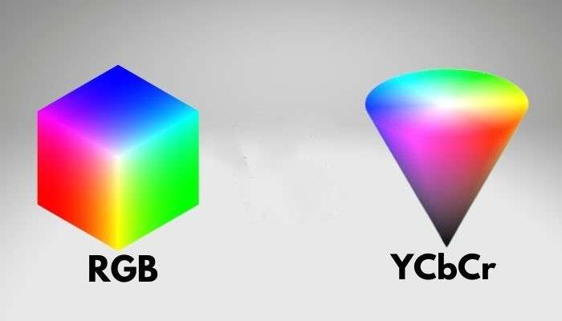
Color Space Conversion
Color space conversion transforms image data from one color representation (color space) to another.
Inputs: RGB image after gamma correction
Outputs: Gray scale image as y channel (luma) and color information (chroma)
bos Semiconductors Confidential

Slide 38
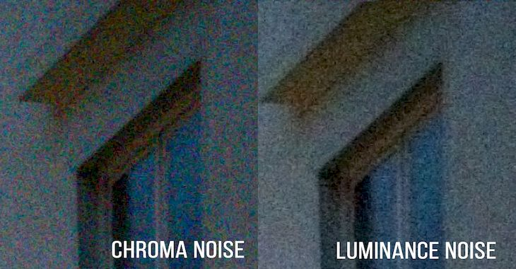
Noise Filter Chroma
Chroma noise appears as random color speckles — usually red, green, or blue dots — especially in dark or flat regions of an image.
Luma noise is noise present in the luminance (brightness) component of an image.
bos Semiconductors Confidential

Slide 39
Noise Filter Chroma
Inputs: Cb and Cr channels of the YCbCr image
Outputs: Cb and Cr channels of YCbCr image after applying noise filter on both
Input Image
Output Image
bos Semiconductors Confidential

Slide 40
Noise Filter Luma
Inputs: 8-bit RGB image (RGB image right Cb and Cr channels of the YCbCr image)
Outputs: Cb and Cr channels of YCbCr image after applying noise filter on both
Input Image
Output Image
bos Semiconductors Confidential

Slide 41
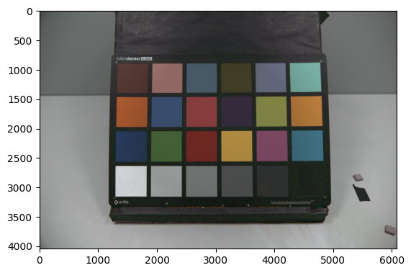
Hue Saturation Control
Inputs: Cb and Cr channels after noise filter for chroma
Outputs: Cb and Cr channels after hue saturation control
Input Image
Output Image
bos Semiconductors Confidential

Slide 42

Thank you

Slide 43
Sub Title Page

Slide 44
Title, Tahoma 32
The summary sentence for this page #1
The summary sentence for this page #2
The summary sentence for this page #3
bos Semiconductors Confidential

Slide 45
Automotive
Fabless
Company
Arm mali c78ae Overview
Dinh Hoang Luan 14-04-2025

Slide 46
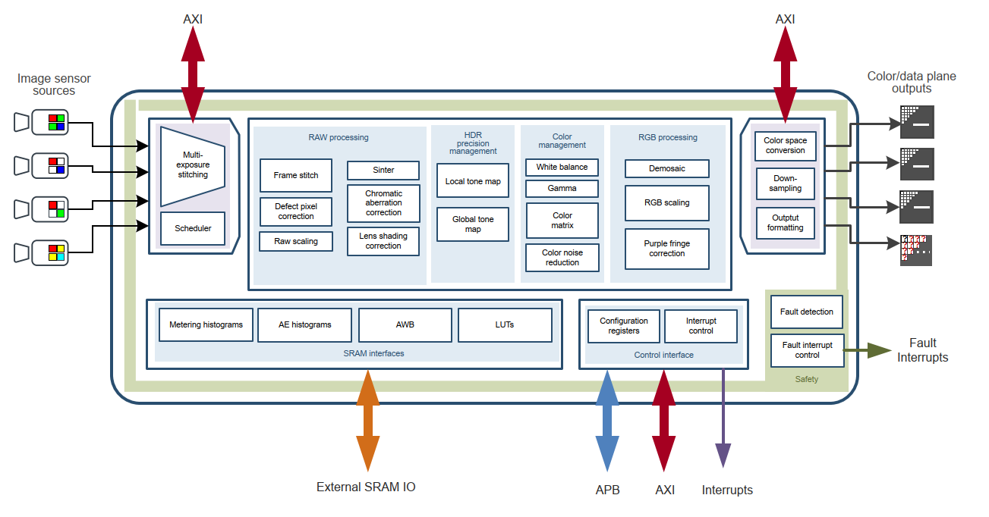
Image Signal Processor Functional View
It support 4 input channels: RGGB, RCCB, RCCG, and RYYCy (each have their own function)
Input Image
Output Image
bos Semiconductors Confidential

Slide 47
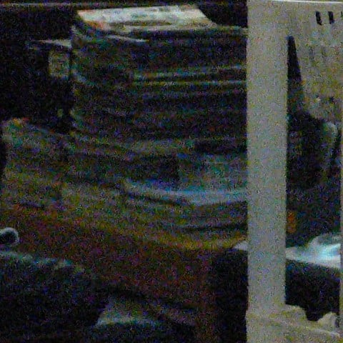
Image Signal Processor Functional View
In automotive applications, the ability to operate in low-luminance (low-light) conditions is critical
In Machine Version, It many don't need color fidelity for pedestrian, car or object detection but need low noise.
A significant benefit of the Bayer pattern is its ability to replicate colors in a manner highly similar to human visual perception. However, the RGB filters in the Bayer pattern present a drawback in performance under low-light conditions.
Image with significant noise in low-light
bos Semiconductors Confidential

Slide 48
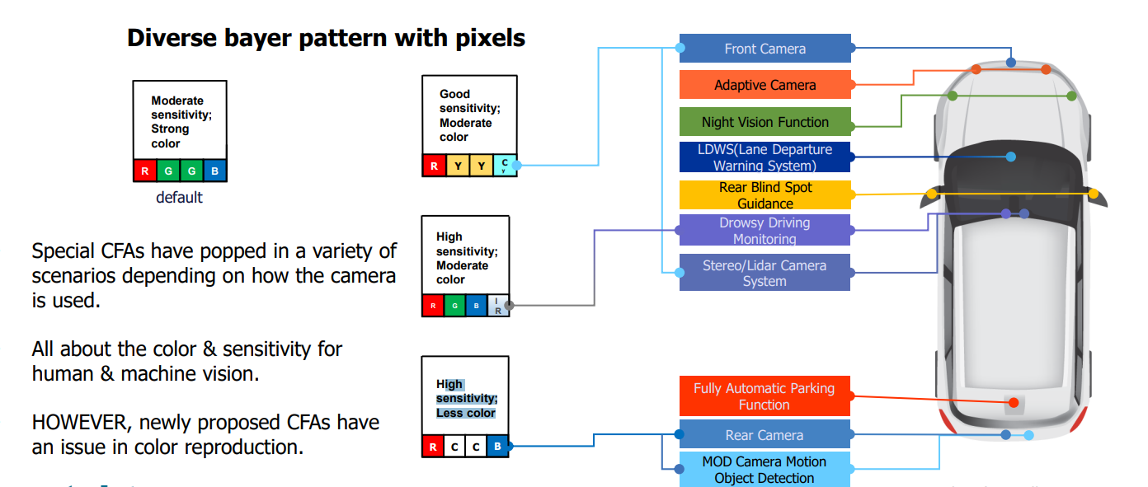
Image Signal Processor Functional View
An example of different type CFA formats use on automotive.
These CFAs significantly affect two critical image quality parameters: noise performance and colour fidelity.
bos Semiconductors Confidential

Slide 49
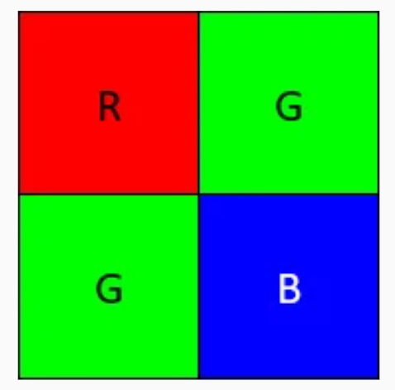
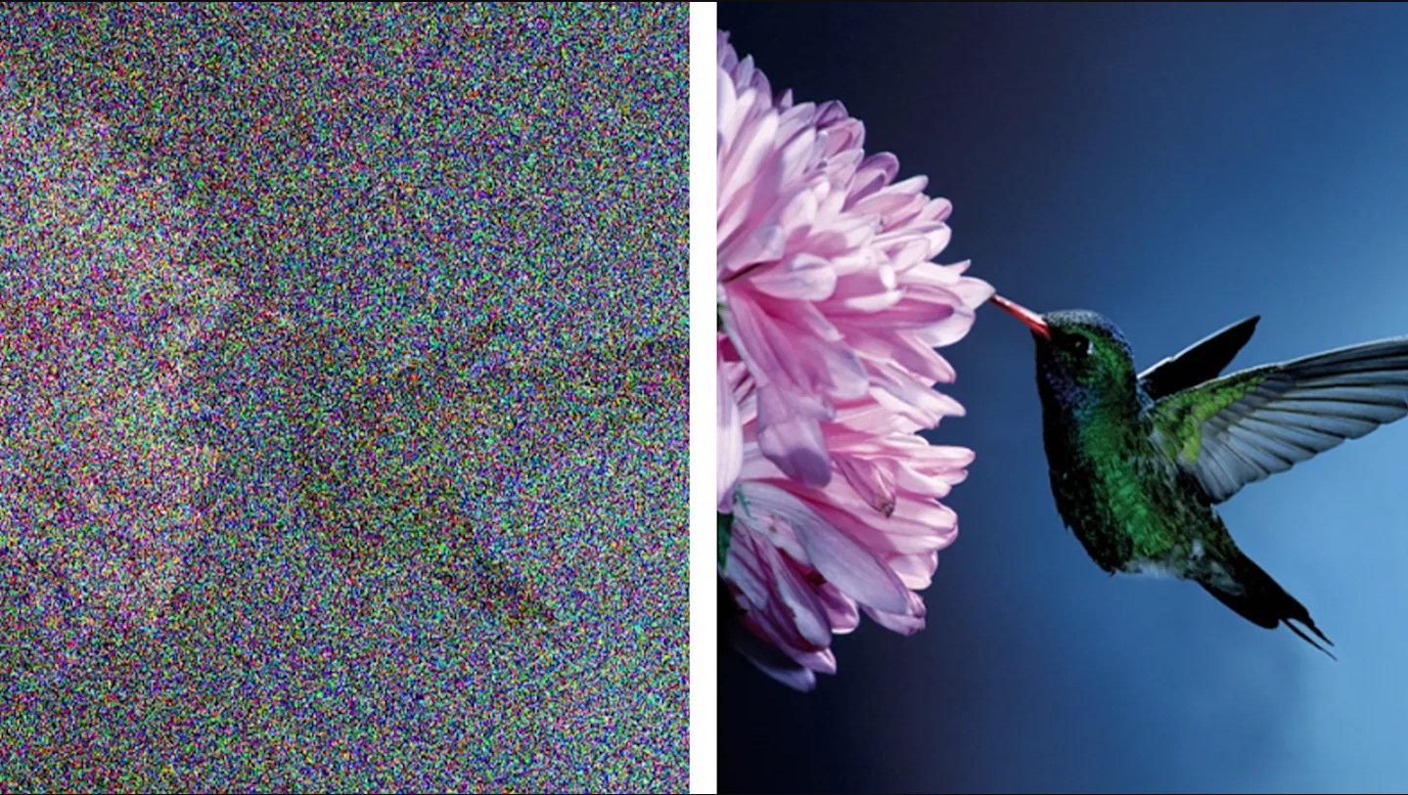
RGGB = Red-Green-Green-Blue
The RGGB pattern, also known as Bayer pattern
Pros: Conduct noise performance, offers excellent color fidelity.
Cons: Higher noise levels in low-light condition, may compromise color accuracy.
RGGB in low-light and high-light conditions
bos Semiconductors Confidential

Slide 50
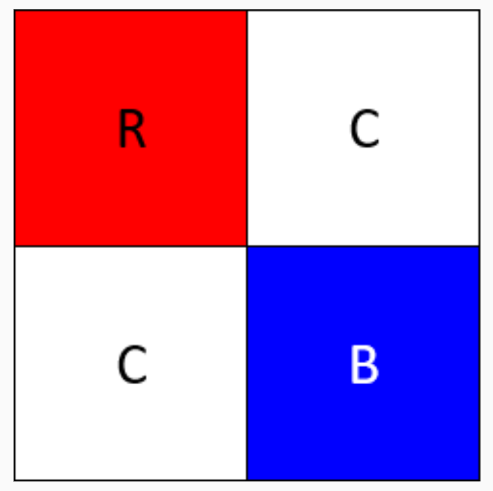
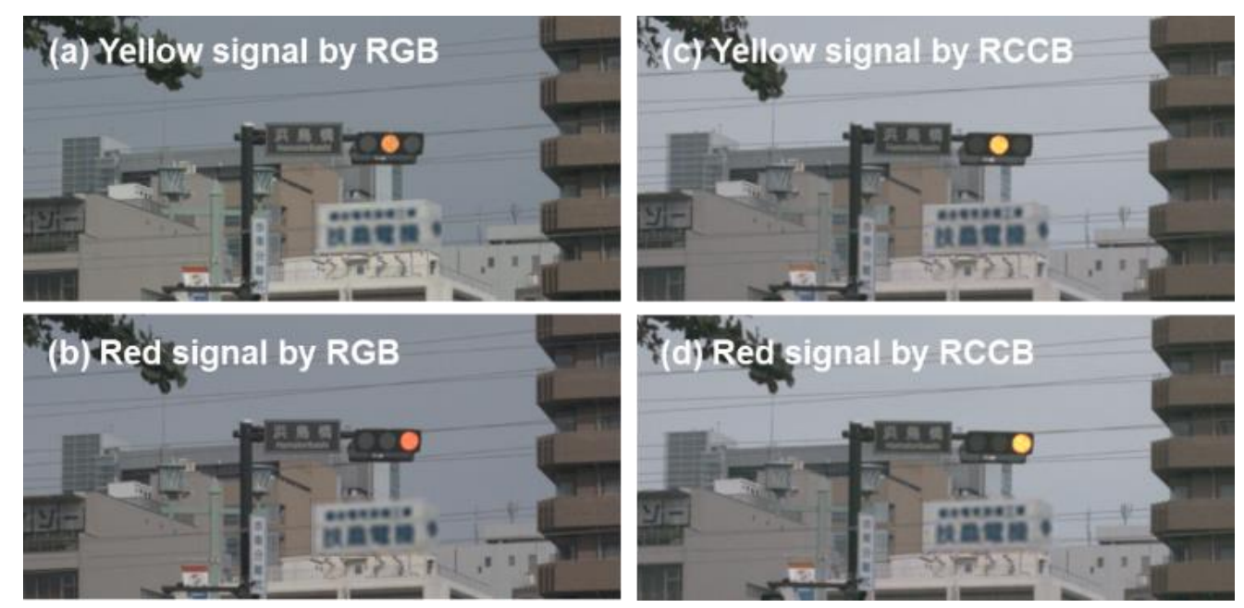
RCCB = Red-Clear-Clear-Blue
RCCB is the simple replacement of green(G) channel by clear(C) channel from RGGB. The purpose of the RCCB pattern is to enhance light sensitivity with clear pixels.
“Clear” includes the green wavelengths, it provides improved luminance information as well as good color information with the red and blue pixels.
Pros: Due to its clear pixels, it offers excellent noise performance, particularly in low-light scenarios. Improved night vision capability.
Cons: Reduced color accuracy due to fewer colored pixels (show the example below).
Yellow/Red traffic signal detection by RGB camera and RCCB
bos Semiconductors Confidential

Slide 51
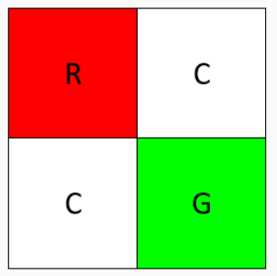
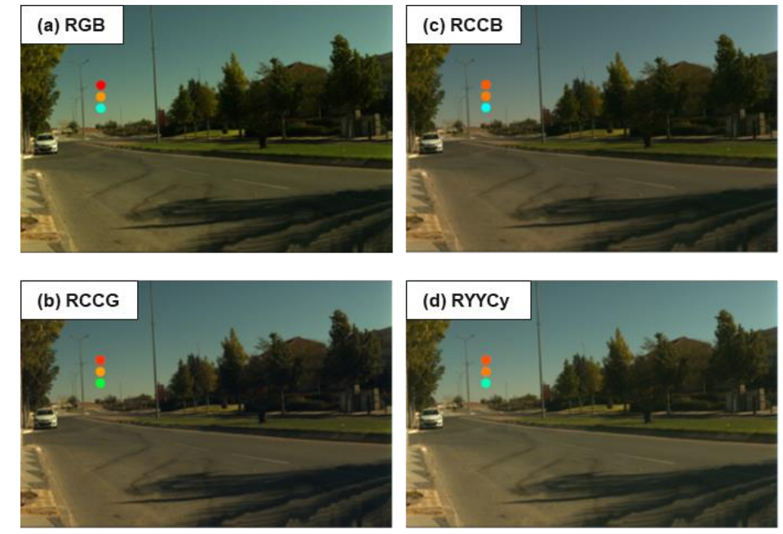
RCCG = Red-Clear-Clear-Green
The concept of RYYCy aims at higher sensitivity in two channels replacing green(G) to yellow(Y) and blue(B) to cyan(Cy) with keeping red(R) channel to be a pure color.
Pros: Good color accuracy for LED signals, streetlights, and urban lighting.
Cons: Reduced color accuracy due to fewer colored pixels
bos Semiconductors Confidential
Yellow/Red traffic signal detection by RGB camera and RCCB

Slide 52
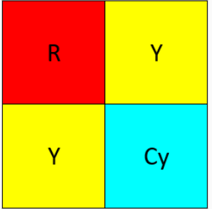
RYYCy = Red-Clear-Clear-Cyan
Cyan is equal parts blue and green.
Cons: Good for differentiating yellow stripes from white stripes.
bos Semiconductors Confidential
Yellow/Red traffic signal detection by RGB camera and RCCB

